Slide 1


LARS A Location-Aware Recommender System
Mohamed Sarwat
Ahmed Eldawy
Mohamed F. Mokbel
Justin Levandoski

Slide 2
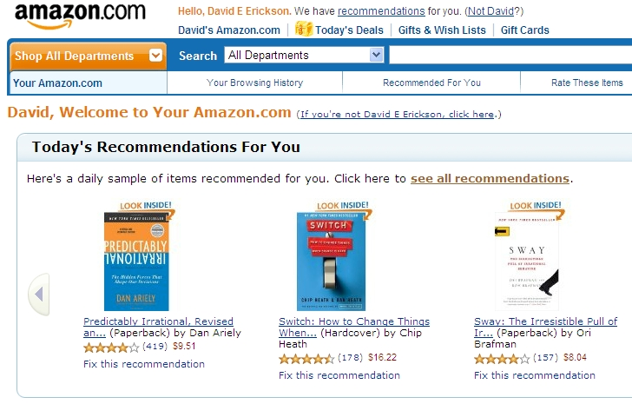
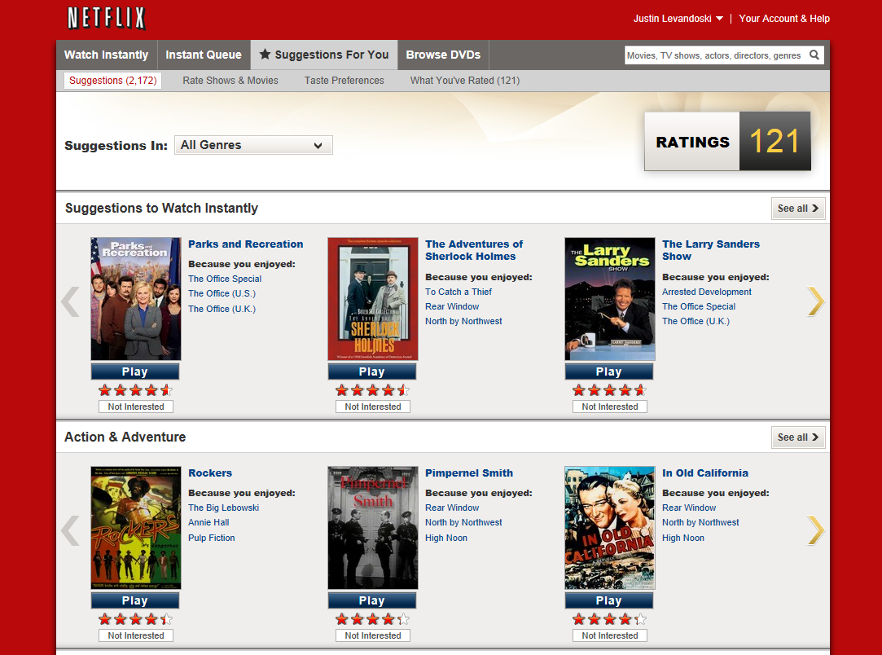
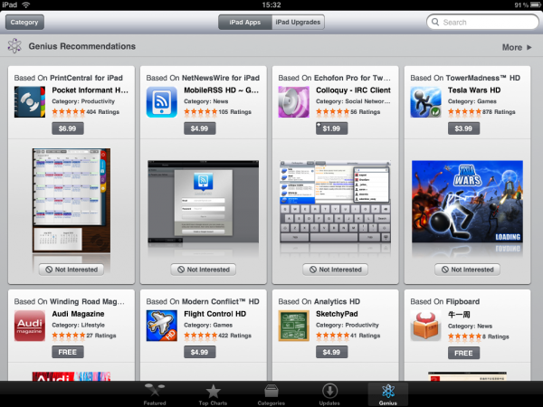
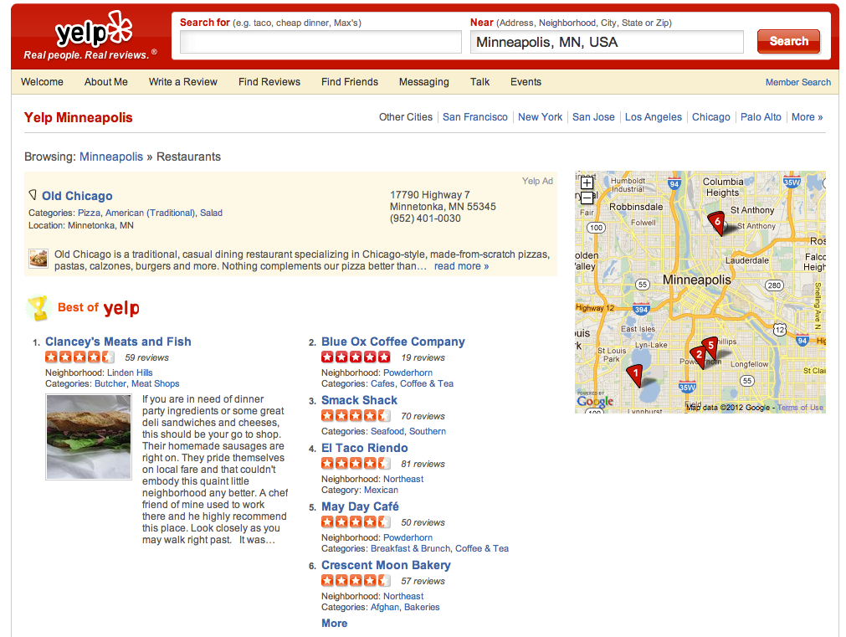
Recommender Systems – Basic Idea (1/2)
Users: provide opinions on items consumed/watched/listened to…
The system: provides the user suggestions for new items
Notes:
1 min: The basic idea of a recommender systems is to gather user opinions/behavior and analyze this information to provide personalized suggestions (recommendations) to individual users
Examples:
Most prominent example is Netflix (users watch movies, provide ratings, netflix provides movie recommendations)
Amazon for books and other products (mix of purchase history and ratings)
Apple iTunes store: apps, TV shows, music

Slide 3
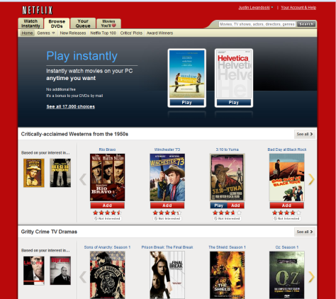


Recommender Systems – Basic Idea (2/2)
Analyze user behavior to recommend personalized and interesting things to do/read/see
Similar
Users
Movie
Ratings
rate movies
build recommendation
model
Similar Items
recommendation
query
“Recommend user A five movies”
Collaborative filtering process is the most commonly used one in Recommender Systems
Notes:
1 min: Netflix Example:
Collaborative filterlig

Slide 4
Location Matters !
Notes:
2 sec

Slide 5

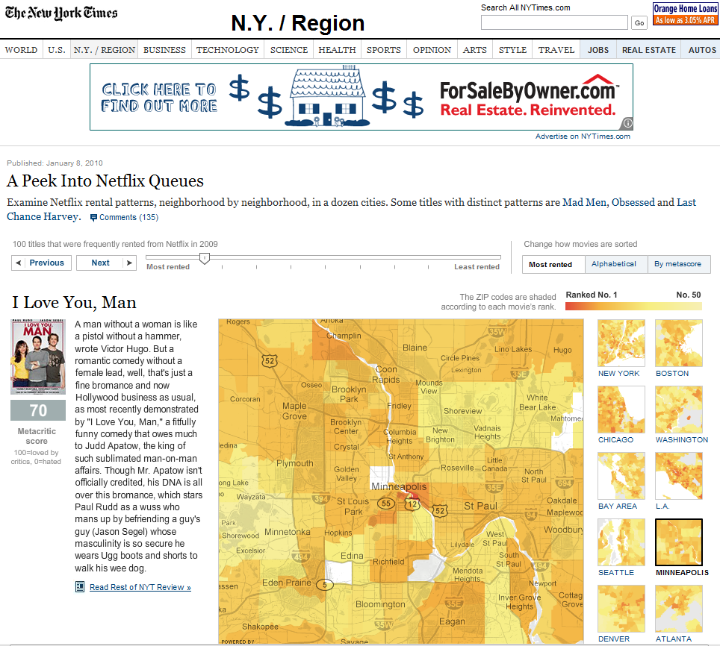
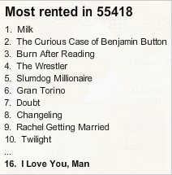
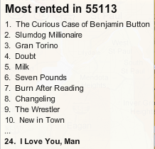
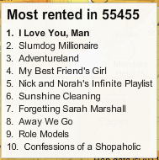
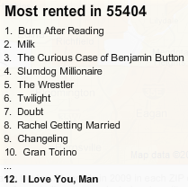
Location Matters: Netflix Rental Patterns
Movie preferences differ based on the user location (zip code)
Preference Locality
Notes:
1 min

Slide 6

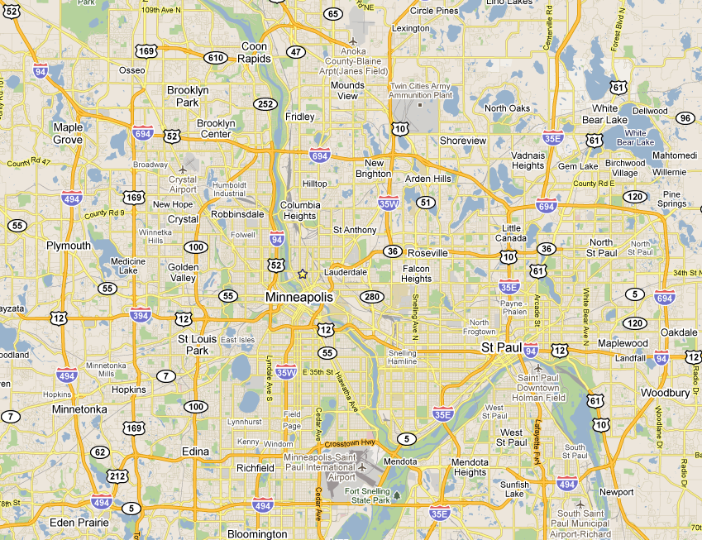
Location Matters: Check-In Destinations in Foursquare
Destination preferences differ based on the user location (zip code) and the destination location
Fousquare users from Robbinsdale tend to visit venues in …
City | % of check-ins
Brooklyn Park | 32%
Robbinsdale | 20%
Minneapolis | 15%
Foursquare users from Falcon Heights tend to visit venues in …
Preference Locality
Fousquare users from Edina tend to visit venues in …
City | % of check-ins
St. Paul | 17%
Minneapolis | 13 %
Roseville | 10%
City | % of check-ins
Edina | 59%
Minneapolis | 37%
Edin Prarie | 5%
Notes:
1 min
Foursquare Data visits data for 1M users to 643K venues across the United States

Slide 7
Location Matters: Travel Distance in Foursquare
Travel Locality
~ 75 % of users travels less than 50 mi
Notes:
1 min

Slide 8
LARS Main Idea
LARS takes into account Preference Locality and Travel Locality when recommending items to users
Notes:
30 sec

Slide 9
Talk Outline
Location-based Ratings
LARS solution
Experimental Evaluation
Conclusion
Notes:
Talk Outline

Slide 10
Talk Outline
Location-based Ratings
LARS solution
Experimental Evaluation
Conclusion
Notes:
Talk Outline

Slide 11
Traditional Recommender Systems
Recommender System
Model
MODEL GENERATION
RECOMMENDATION GENERATION
Recommend Items To Users
User | Item | Rating
Mike | The Muppets Movie | 4.5
. | . | .
. | . | .
. | . | .
. | . | .
. | . | .
Rating Triplet :
User: The user who rates the item
Item: The item being rated (movies, books)
Rating: The rating score (e.g., 1 to 5)
User/Item Ratings
Notes:
30 sec

Slide 12
Incorporating Users Locations
User
Mike
Alice
.
.
.
.
Item
The Muppets
The Matrix
.
.
.
.
uLocation
Circle Pines, MN
Edina, MN
.
.
.
.
Rating
5
2
.
.
.
.
Example: Mike located at home (Circle Pines, MN) rating “The Muppets” movie
Mike
Example: Alice located at home (Edina, MN) rating “The Matrix” movie
Alice
Notes:
1 min

Slide 13
Incorporating Items Locations
User
Bob
.
.
.
.
.
Item
Restaurant X
.
.
.
.
.
Rating
.4.5
.
.
.
.
.
iLocation
Brooklyn Park, MN
.
.
.
.
.
Example: Bob with unknown location rating restaurant X located at Brooklyn Park, MN
Restaurant X
Restaurant Y
Notes:
1 min

Slide 14
Incorporating Both Users and Items Locations
User
Mike
Alice
.
.
.
.
uLocation
Circle Pines, MN
Edina, MN
.
.
.
.
Item
Restaurant X
Restaurant Y
.
.
.
.
iLocation
Brooklyn Park, MN
Mapplewood, MN
.
.
.
.
Rating
4.5
2
.
.
.
.
Restaurant X
Mike
Example: Mike located at Circle Pines, MN rating a restaurant X located at Brooklyn Park, MN
Restaurant Y
Alice
Notes:
1 min

Slide 15
Location-based Ratings Taxonomy
LARS goes beyond the traditional rating triple (user, item, rating) to include the following taxonomy:
Spatial User Rating for Non-spatial Items
(user_location, user, item, rating)
Example: A user with a certain location is rating a movie
Recommendation: Recommend me a movie that users within the same vicinity have liked
Non-spatial User Rating for Spatial Items
(user, item_location, item, rating)
Example: A user with unknown location is rating a restaurant
Recommendation: Recommend a nearby restaurant
Spatial User Rating for Spatial Items
(user_location, location, item_location, item, rating)
Example: A user with a certain location is rating a restaurant
Notes:
30 sec

Slide 16
Talk Outline
Location-based Ratings
LARS solution
Spatial User Ratings for Non-Spatial Items
Non-Spatial User Ratings for Spatial Items
Spatial User Ratings for Spatial Items
Experimental Evaluation
Conclusion
Notes:
Talk Outline

Slide 17
Talk Outline
Location-based Ratings
LARS solution
Spatial User Ratings for Non-Spatial Items
Non-Spatial User Ratings for Spatial Items
Spatial User Ratings for Spatial Items
Experimental Evaluation
Conclusion
Notes:
Talk Outline

Slide 18





Spatial User Ratings For Non-Spatial Items (1/3)
1. Partition ratings by user location
Cell 1
Cell 2
Cell 3
C
C
(x₇, y₇)
B
(x₂, y₂)
(x₆, y₆)
3
3
4
2
4
5
4
User Partitioning !
How ?
B
B
A
C
(x₃, y₃)
(x₄, y₄)
(x₁, y₁)
(x₅, y₅)
2. Build collaborative filtering model for each cell using only ratings contained within the cell
3. Generate recommendations using collaborative filtering using the model of the cell containing querying user
Cell 1
Cell 2
Cell 3
Build Collaborative
Filtering Model using:
Build Collaborative
Filtering Model using:
Build Collaborative
Filtering Model using:
Cell 1
Cell 2
Cell 3
User | Item | Rating
A |  | 4
C |  | 5
User | Item | Rating
B |  | 3
B |  | 3
C |  | 4
User | Item | Rating
B |  | 4
C |  | 5
Querying user
Recommendation
List
Notes:
1 min
Example

Slide 19
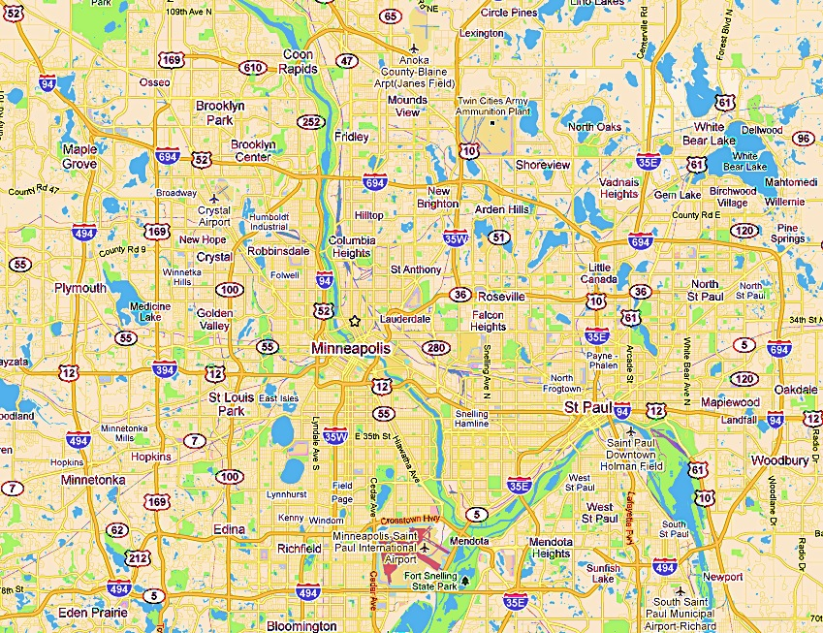
Spatial User Ratings For Non-Spatial Items (2/3)
User Partitioning
Regular Collaborative Filtering
Adaptive Pyramid Structure.
Three main goals:
Locality
Scalability.
Influence.
Influence Levels
Smaller cells → more “localized” answers
Notes:
1 min
Tradeoff (locality + scalability)
Influence
queries

Slide 20
Spatial User Ratings For Non-Spatial Items (3/3)
Merging: reduces the number of maintained cells
4-cell quadrant at level (h+1) “merged” into parent at level h
Queries at level (h+1) now service at level h for merged region
Merging decision made on trade-off between locality loss and scalability gain
Splitting: increases number of cells
Opposite operation as merging
Splitting decision made on trade-off between locality gain and scalability loss
Maintenance results in partial pyramid structure
Notes:
1 min
Merging (tradeoff between locality loss and scalability gain)
Splitting (tradeoff between locality gain and scalability loss)
Partial pyramid structure

Slide 21
Talk Outline
Location-based Ratings
LARS solution
Spatial User Ratings for Non-Spatial Items
Non-Spatial User Rating for Spatial Items
Spatial User Ratings for Spatial Items
Experimental Evaluation
Conclusion
Notes:
Talk Outline

Slide 22



Non-Spatial User Ratings For Spatial Items (1/2)
Penalize the item based on its distance from the user.
We normalize the item distance from the user to the ratings scale (i.e., 1 to 5) to get the Travel Penalty.
(x₁, y₁)
Travel Penalty
Notes:
1 min
Travel Penalty Example
Penalize the item based on its distance from the user.
We normalize the item distance from the user to the ratings scale (i.e., 1 to 5) to get the Travel Penalty.

Slide 23
Non-Spatial User Ratings For Spatial Items (2/2)
Penalize each item, with a travel penalty, based on its distance from the user.
Use a ranking function that combines the recommendation score and travel penalty
Incrementally, retrieve items based on travel penalty, and calculate the ranking score on an ad-hoc basis
Employ an early stopping condition to minimize the list of accessed items to get the K recommended items
Notes:
30 sec
Penalize items
Ranking funtion (Recommendation score + travel penalty)
Incrementally retrieve items (by travel penalty)
Early terminiation condition to reduce the list of accessed items to get k recommendation to the user.

Slide 24
Talk Outline
Location-based Ratings
LARS solution
Spatial User Ratings for Non-Spatial Items
Non-Spatial User Ratings for Spatial Items
Spatial User Ratings for Spatial Items
Experimental Evaluation
Conclusion
Notes:
Talk Outline

Slide 25
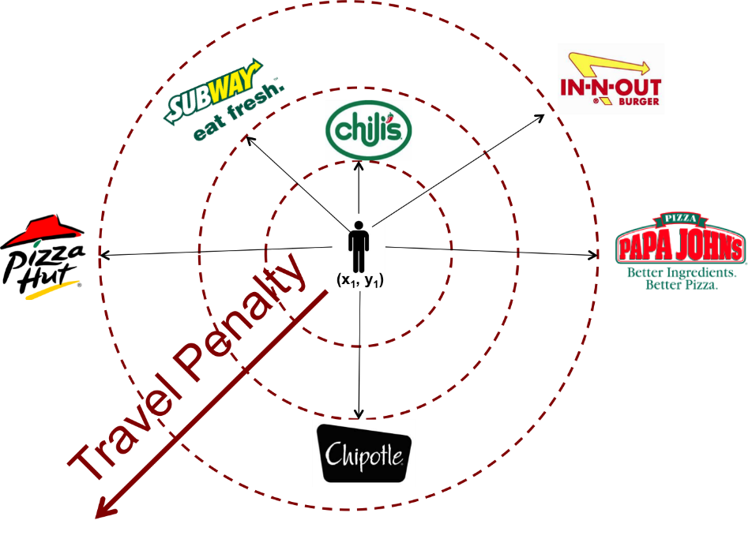
Spatial User Ratings For Spatial Items
Use both Travel Penalty and User Partitioning in concert
+
User Partitioning + Travel Penalty
Notes:
30 sec

Slide 26
Talk Outline
Location-based Ratings
LARS solution
Spatial User Ratings for Non-Spatial Items
Non-Spatial User Ratings for Spatial Items
Spatial User Ratings for Spatial Items
Experimental Evaluation
Conclusion
Notes:
Talk Outline

Slide 27
Experiments: Data Sets
Three Data Sets:
Foursquare:
~ 1M users and ~600K venues across the USA.
MovieLens:
~90K ratings for ~1500 movies from ~1K users. Each rating was associated with the zip code of the user who rated the movie.
Synthetic:
2000 users and 1000 items, and 500,000 ratings.
Techniques: (M is parameter tuned to get the tradeoff between locality and scalability)
LARS-U: LARS with User Partitioning (only)
LARS-T: LARS with Travel Penalty (only)
LARS-M=1: LARS preferring locality over scalability (more splitting)
LARS-M=0: LARS preferring scalability over locality (more merging)
CF: regular recommendation (collaborative filtering)
Notes:
1 min

Slide 28
Experiments: Evaluating Recommendation Quality
Foursquare Data
More localized recommendations gives better quality
Notes:
30 sec

Slide 29
Experiments: Evaluating Scalability
Synthetic Data Set
Storage and Maintenance increases exponentially
Notes:
30 sec

Slide 30
Experiments: Evaluating Query Performance
Synthetic Data Set
Snapshot Queries
Continuous Queries
Query Performance in LARS is better than its counterparts
Notes:
30 sec

Slide 31
Talk Outline
Location-based Ratings
LARS solution
Spatial User Ratings for Non-Spatial Items
Non-Spatial User Ratings for Spatial Items
Spatial User Ratings for Spatial Items
Experimental Evaluation
Conclusion
Notes:
Talk Outline

Slide 32
Take-Away Message
LARS promotes Location as a first class citizen in traditional recommender systems.
LARS presents a neat taxonomy for location-based ratings in recommender system.
LARS employs a user partitioning and travel penalty techniques which can be applied separately or in concert to support the various types of location-based ratings.
Notes:
1 min

Slide 33
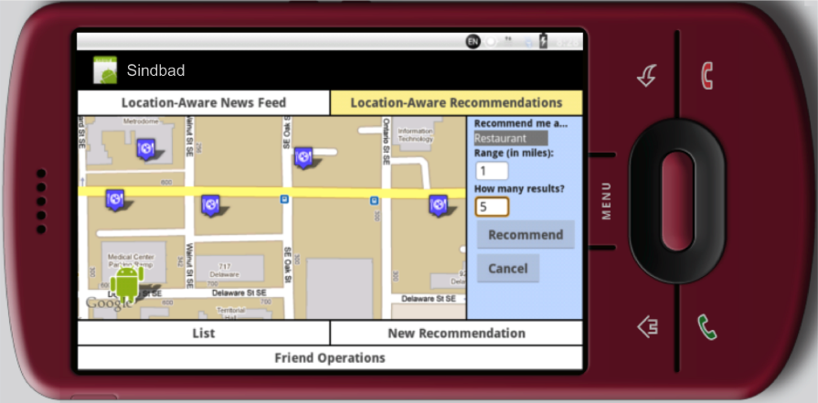
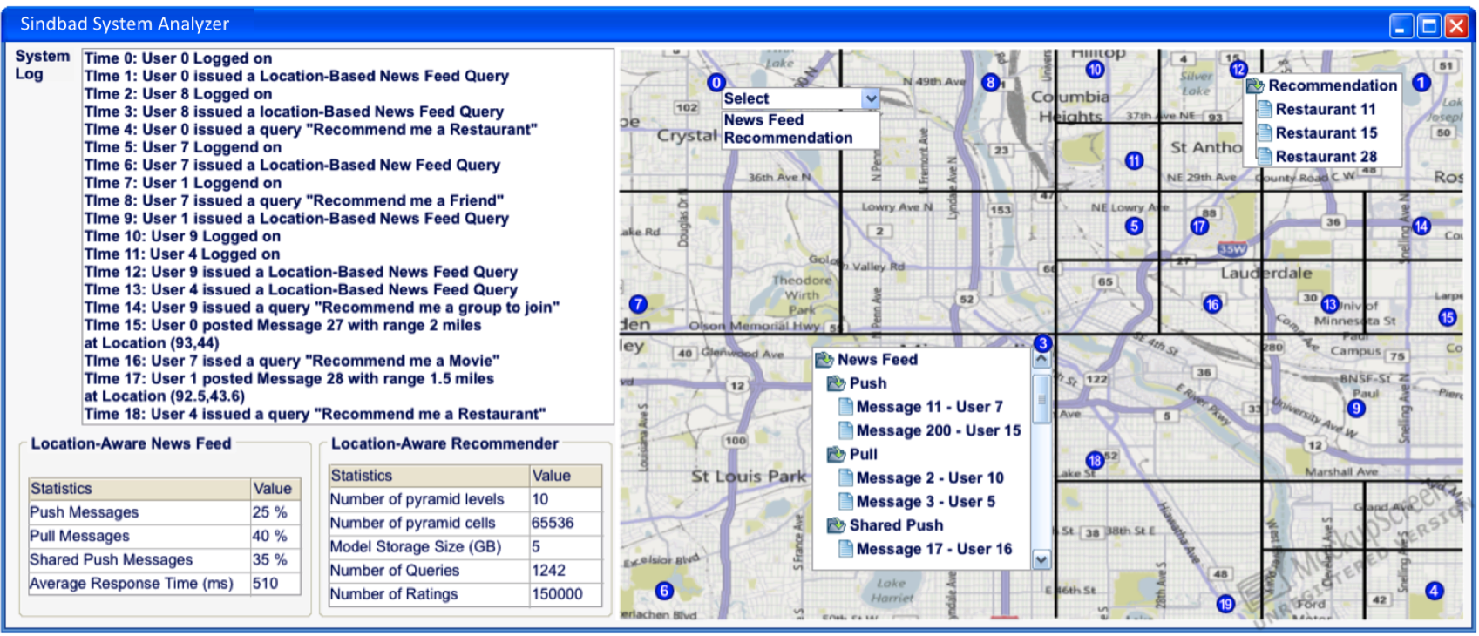
LARS in Action (SIGMOD 2012 Demo)
Mohamed Sarwat, Jie Bao, Ahmed Eldawy, Justin j. Levandoski, Amr Magdy, Mohamed F. Mokbel. “Sindbad: A Location-Aware Social Networking System”. to appear in SIGMOD 2012
Notes:
30 sec

Slide 34
Questions

Slide 35
Thank You

Slide 36



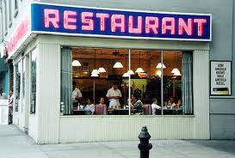
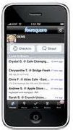


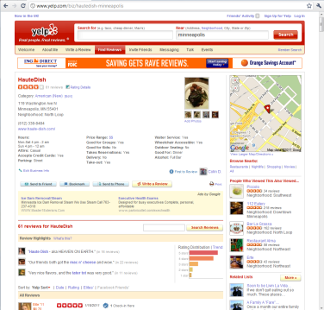
Location-Based Ratings Taxonomy
“Kings Speech: 5 stars!”
Spatial Rating for Non-Spatial Items
(user, user_location, item, rating)
Example
(“Al”, (x₁,y₁), “king’s speech”, 5)
(x₁, y₁)
“Great Restaurant:
4 stars”
Spatial Rating for Spatial Items
(user, user_location, item, item_location, rating)
Mobile search for “restaurant”
“Check In”
Example
(“Al”, (x₁,y₁), “restaurant”, (x₂,y₂), 4)
30 minutes later
(x₁, y₁)
(x₂, y₂)
Restaurant Alma is great! 5 stars
Non-Spatial Rating for Spatial Items
(user, item, item_location, rating)
User location not available
Example
(“Al”, “restaurant alma”, (x₂,y₂), 5)

Slide 37


Non-Spatial User Ratings For Spatial Items (1/3)
Penalize the item based on its distance from the user.
We normalize the item distance from the user to the ratings scale (i.e., 1 to 5) to get the Travel Penalty.
Travel Penalty
2
0.5
Travel Penalty
2.5
1
(x₁, y₁)
0.85
2.25

Slide 38
Non-Spatial User Ratings For Spatial Items (3/3)
Recommend me 3 restaurants
Step 1: Get the 3 items with less penalty
Step 2:
Get predicted rating for 3 items (assume ratings for chili’s, pizzhut, chipotle are 3, 5, 4).
calculate the recommendation score (RecScore = Predicted Rating – Penalty)
Step 3:
Rank the 3 items based on RecScore 1. 2. 3.
Set LowestMaxScore to RecScore of the 3rd item in the list (LowestMaxScore = 3.15)
Step 4:
Get next item with lowest penalty score
Assign the Maximum possible Rating (i.e., 5) to
Set its Maximum possible score to be (MaxPossibleScore = 5 – 2 = 3)
As MaxPossibleScore (3) < the LowestMaxScore (3.15), the algorithm will terminate.
RecScore = 3 -0.5 = 2.5
RecScore = 5 -1 = 4
RecScore = 4 -0.85 =3.15
Result:

Slide 39
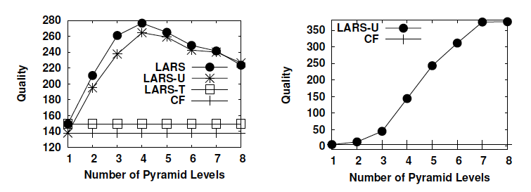
Evaluating Quality
Foursquare
MovieLens
More localized recommendations gives better quality

Slide 40
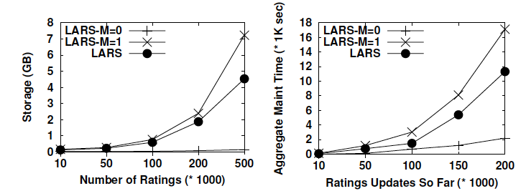
Experiments: Evaluating Scalability
Synthetic Data Set
Storage
Maintenance
Storage and Maintenance increases exponentially

Slide 41
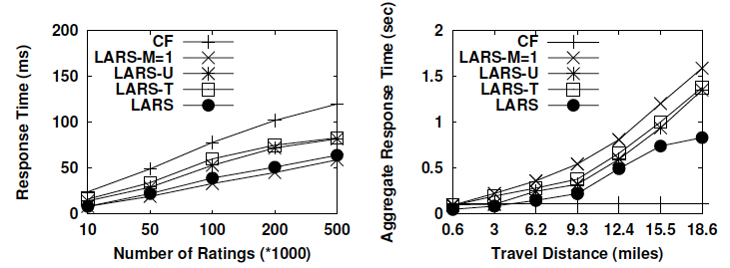
Experiments: Evaluating Query Performance
Synthetic Data Set
Snapshot Queries
Continuous Queries
Query Performance in LARS is better than its counterparts

